Slide 1
MEGAURETER : Definition, Prenatal diagnosis and Pathophysiology
DR. AADIL FAROOQ,
Consultant Pediatric Urology,
Jaipur.

Slide 2
Definition
A normal ureter measures less than 5 mm.
Megaureter is defined as a ureter that exceeds the upper limits of normal size.
In children, any ureter greater than 7 mm in diameter is considered a megaureter based on measurements in fetuses greater than 30 weeks gestation and children <12 years.
(British association of Pediatric Urologists)
It is simply a descriptive term about the diameter of ureteric lumen.
It does not imply any description of function in terms of obstruction or reflux.
Cussen LJ ., Invest Urol. 1967;5(2):164.

Slide 3
CLASSIFICATION:
Megaureters may be etiologically divided into:
PRIMARY- intrinsic to ureter
SECONDARY- bladder and bladder outlet
Megaureter can be classified as:
based on SMITH’s classification.
1. Obstructed,
2. Refluxing ,and
3. Non obstructed non-refluxing.
KING’s Classification-
Includes fourth variant;i.e. Obstructed and Refluxing
So, according to KING Megaureter can be classified as:
1. Obstructed,
2. Refluxing ,and
3. Non obstructed non-refluxing
4. Obstructed and Refluxing
Refs: David B. Joseph,Ped Urol. 2010…………..

Slide 4
ANTENATAL DIAGNOSIS

Slide 5
ANTENATAL DIAGNOSIS
When ANH is detected on antenatal screening (1-3 %),
an ultrasound is recommended
at 16-20 weeks of gestation for evaluation of
Lower urinary tract obstruction (Distended bladder)
2. Oligohydramnios
Renal dysplasia- parenchymal thinning, cysts, raised echogenicity, loss of CMD and
4. extrarenal structural malformation

Slide 6
ANTENATAL DIAGNOSIS
Megaureter constitutes about 25% of cases of antenatal hydronephrosis.
The guidelines proposed for antenatal evaluation
In fetuses with UNILATERAL HYDRONEPHROSIS/HYDROURETER, at least one follow up ultrasound be performed in the third trimester. (Grade1B)
Those fetuses with BILATERAL HYDRONEPHROSIS/HYDROURETER, be monitored frequently.
(Grade 2C)
Sinha et al., Ind. Pediatrics. 2013

Slide 7
ANTENATAL DIAGNOSIS
The frequency of monitoring varies
every 4-6 weeks,
depending on gestation, severity and oligohydramnios
Fetuses with findings suggestive of lower urinary tract obstruction
bilateral hydroureteronephrosis,
dilated bladder and oligohydramnios
might require even more frequent monitoring
Sinha et al., Ind. Pediatrics. 2013

Slide 8
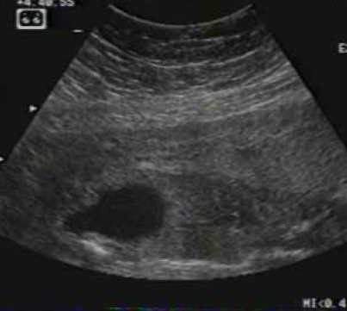
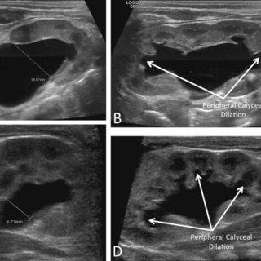
Bilateral Hydro-uretronephrosis
( Rt. & Lt.)
Dilated Bladder

Slide 9
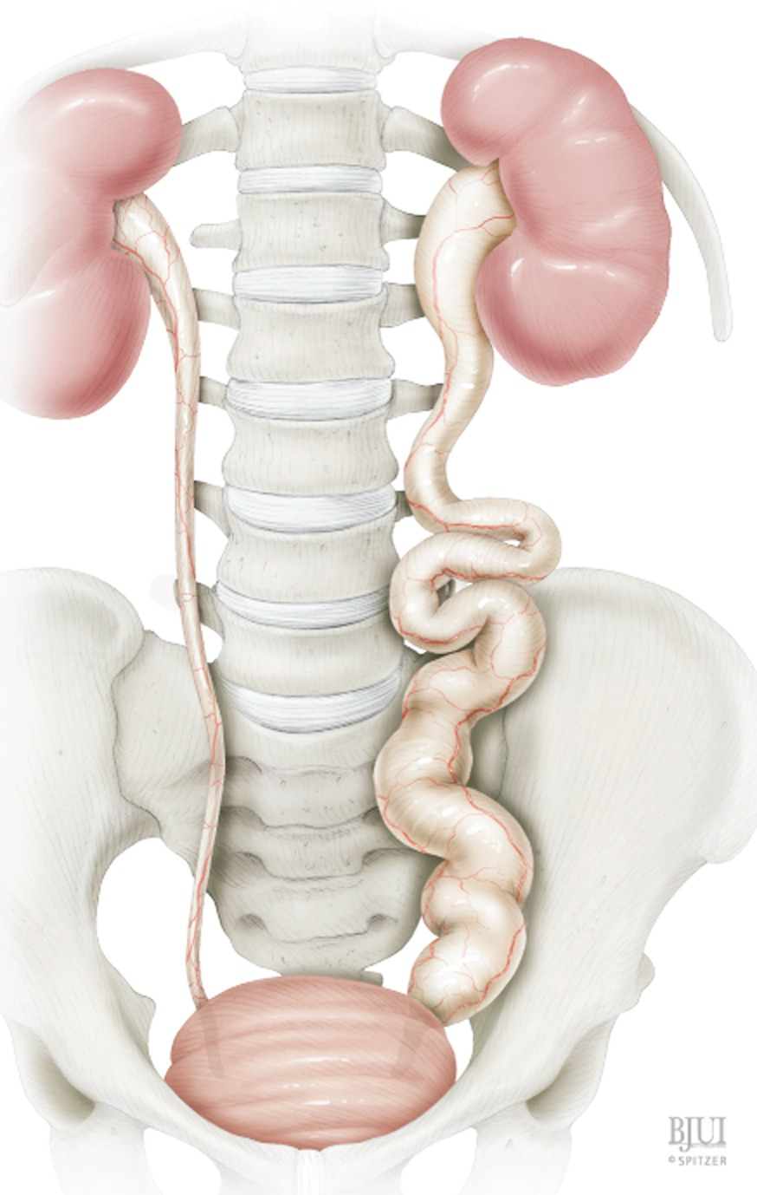
PATHOPHYSIOLOGY of Megaureter

Slide 10
Hydrodynamics of Megaureter
PATHOPHYSIOLOGY
of Megaureter
The principal function of ureter is to transport urine from kidney to the bladder.
This transport mechanism includes
distension,
myogenic and
neurogenic activities
Due to dilatation of ureter c/b distal obstrution, the uretral lumen is incompletely obliterated by contraction( coaptation),
the peristalsis is not bolus producing and retrograde regurgitation occurs due to distal obstruction
Also the laminar flow becomes turbulent distally, which is harmful to the kidney and bacterial washout which normally occurs.
This leads to secondary bacterial infection.
Hanna MK, J.Urol, 1979…

Slide 11
PATHOPHYSIOLOGY
of Megaureter
Hydrodynamics of Megaureter
Law of LAPLACE:
Pressure= Tension x wall Thickness / Radius
i.e. Increased ureteric diameter decreases the intraluminal pressure
Hence, Surgical Reconstruction includes
1. Reduction of diameter of ureter which results in coaptation and generate pressure to propel the urinary bolus distally
Also , it should include
2. Excision of the obstructing segment, and
3. Reimplantation of Ureter into bladder by reflux preventing mechanism

Slide 12
PATHOPHYSIOLOGY of Megaureter
According to Kings classification
Pathophysiology has been dictated by Ureteral classification
1. Primary Obstructed Megaureter:
constitutes 25% cases of obstructive uropathy ,
bilateral in 25%,
M:F 4:1
Left more common than right.

Slide 13
Primary Obstructed Megaureter
represents functional obstruction with terminal adynamic segment at juxtavesical portion of distal ureter.
This leads to non propagation of peristaltic wave
Causes of obstructive Megaureter:
dense collagen (type I,III) infiltration of terminal ureter
B. distal circular muscle hypertrophy
distal muscular dysplasia
Lee et. Al. demonstrated altered collagen to smooth muscle ratio:
Normal ureters:0.52
Obstructed ureters:0.78
Refluxing megaureters:1.99

Slide 14

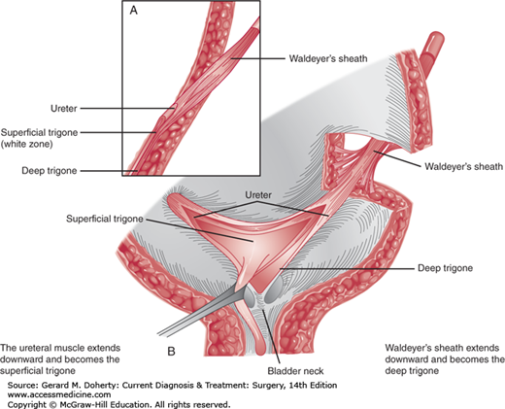

Slide 15
Other factors
Increased levels of
TGF –b affects maturation of smooth muscle, and leads
to segmental hypoplasia of longitudinal muscle involved in peristalsis
Angiotensin type II Receptors-affects contractile function of smooth muscle.
Other anatomical causes
Congenital distal ureteric strictures,
Distal ureteric valves

Slide 16
PATHOPHYSIOLOGY of Megaureter
Secondary Obstructed Megaureter
Secondary to elevated intravesical pressure
Secondary to
Spinal dysraphism
Neurogenic bladder- intravesical pressure >40 cm H2O
Non neurogenic voiding dysfunction
Ureterocele
Ectopic ureter
Posterior urethral valves
Bladder diverticula

Slide 17
PATHOPHYSIOLOGY of Megaureter
PRIMARY REFLUXING MEGAURETER
There is deficiency of uretero-trigonal unit.
The pathology involves a short intravesical ureter and submucosal tunnel.
The distal ureteral musculature is attenuated.
There is altered Paquins Ratio of 5:1.
Histology
There is increased type III collagen in distal ureter.
These abnormalities account for patulous appearance and lateral displacement of ureteric orifice seen on cystoscopy.

Slide 18
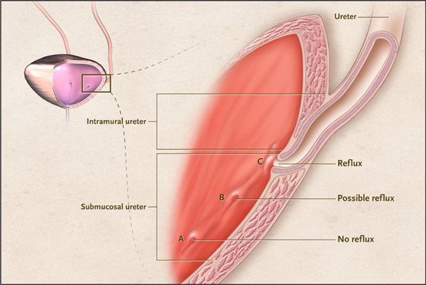

Slide 19
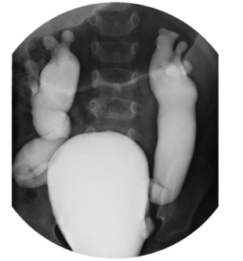
SECONDARY REFLUXING MEGAURETER
Megacystis megaureter syndrome-thin walled and dilated bladder and ureters.
Prune Belly syndrome
MCU

Slide 20
PATHOPHYSIOLOGY of Megaureter
REFLUXING OBSTRUCTED MEGAURETER
In refluxing megaureters, 2% also have some degree of obstruction.
The ureter fails to coapt leading to reflux, and donot transmit peristalsis leading to obstruction.
ECTOPIC URETERs at bladder neck,
These exhibit Reflux when relaxed, Obstruct on contraction.
PRIMARY NON OBSTRUCTIVE, NON REFLUXING MEGAURETER
Maturation Delay Hypothesis:
The fetus makes larger volumes of urine compared to infant.
When this diuresis precedes the natural canalization of ureter, a megaureter may develop even in the absence of obstruction and reflux

Slide 21


